Slide 1
Teamwork & Collaboration
Soft Skills
Notes:
Instructor:
Read through the whole lesson (including all the notes) before the day of class
Make note of and gather any supplies you need to bring
Prepare examples, stories
Think through how much time you want to spend on individual activities; make notes
Be sure to allow time to announce the assignment at the end
Overview:
Intro (slides 1-4): 2 minutes
Importance of teams (slides 5-9): 5 minutes
Examples of great teams (slides 10-33): 10 minutes
Best Practices (slides 34-40): 10 minutes
Paper towel exercise (41-53): 22 minutes
Wrap-up: 1 minute
Total: 50 minutes

Slide 2
Prepare
Obtain at least the suggested amount of the following materials for the in-class activity (contact your ACME department professor if you need reimbursement):
1-2 reams of printer paper (~500 pages)
500 paper clips
Four dispensers of Scotch tape
Other “crafting” materials (optional)
(e.g., thumbtacks, glue sticks, etc.)
Measuring tape (to determine winner)

Slide 3
Review
Fully recognize the power that public speaking has.
Learn key elements of public speaking
Identify public speaking best practices.
Apply said practices with an impromptu speech.
Establish improvement plan.
Notes:
Outcomes from last time

Slide 4
Outcomes
Discuss the importance of teams
Watch examples of great teams in action
Identify best practices in teamwork
Participate in Paper Tower exercise

Slide 5
Importance of Teams
ACME Seminar
Notes:
Overview:
Intro (slides 1-4): 2 minutes
Importance of teams (slides 5-9): 5 minutes
Examples of great teams (slides 10-33): 10 minutes
Best Practices (slides 34-40): 10 minutes
Paper towel exercise (41-53): 22 minutes
Wrap-up: 1 minute
Total: 50 minutes

Slide 6
Definition
Team: A small group of people with complementary skills who operate according to a common purpose, process, and results, who are mutually accountable to one another.

Slide 7
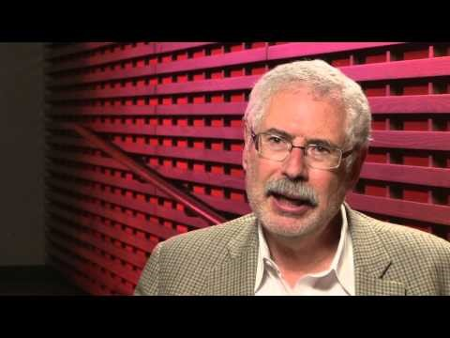

Slide 8
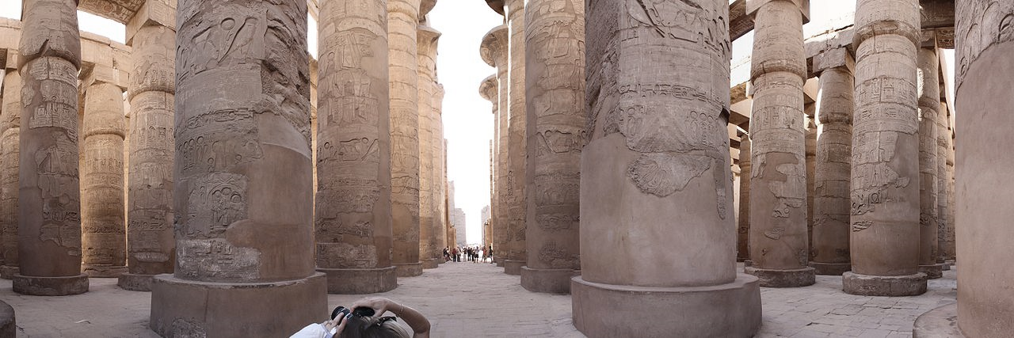
Reflect
Why are teams important?
Example: Ramses the Great
Ramses the Great was a great builder in ancient Egypt. A strong majority of famous Egyptian statues and monuments were built under his reign.
…who built them? (Slaves)
Notes:
Image from https://en.wikipedia.org/wiki/Karnak#/media/File:Karnakpanorama.jpg

Slide 9
Take-away
Without others, Ramses would not be remembered. He could not have done what he did alone.
We need teams to achieve things greater than ourselves.

Slide 10
Examples of Great Teams
ACME Seminar
Notes:
Overview:
Intro (slides 1-4): 2 minutes
Importance of teams (slides 5-9): 5 minutes
Examples of great teams (slides 10-33): 10 minutes
Best Practices (slides 34-40): 10 minutes
Paper towel exercise (41-53): 22 minutes
Wrap-up: 1 minute
Total: 50 minutes

Slide 11
Name that team
Can you name each of the following 21 teams?
(Go fast—less than 5 seconds each)

Slide 12
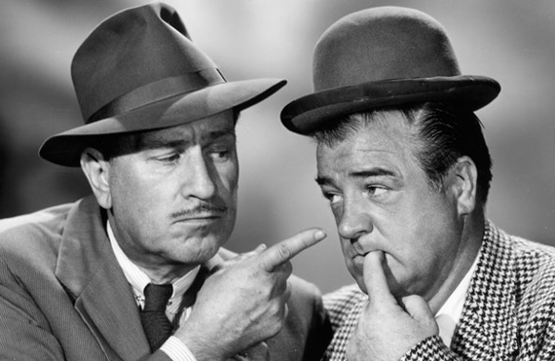
Abbott and Costello
Notes:
Source: http://capitalandmain.com/wp-content/blogs.dir/13/files/2014/05/Abbott-Costello.jpg

Slide 13
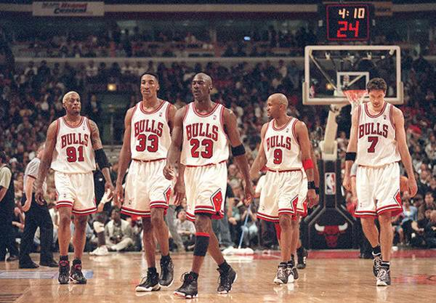
1995 Chicago Bulls
Notes:
Source: https://faltaofensiva.files.wordpress.com/2016/01/chicago-bulls2.jpg?w=600

Slide 14
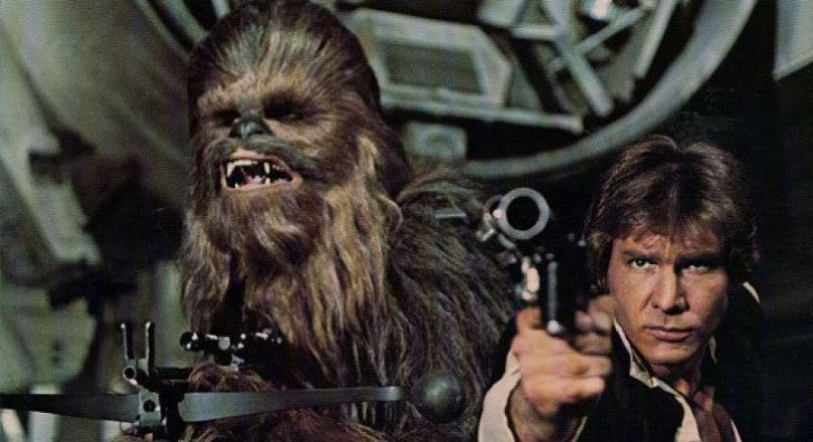
Han and Chewie
Notes:
Source: http://www.themarysue.com/wp-content/uploads/2016/03/han-and-chewie.jpg

Slide 15
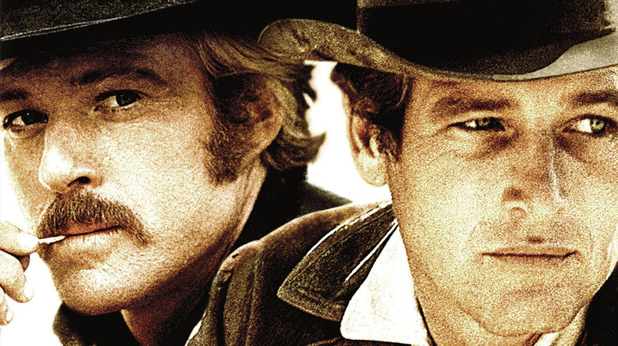
Butch Cassidy and the Sundance Kid
Notes:
Source: http://www.asset1.net/tv/pictures/movie/butch-cassidy-and-the-sundance-kid-1969/Butch-Cassidy-And-The-Sundance-Kid-DI-to-L10.jpg

Slide 16
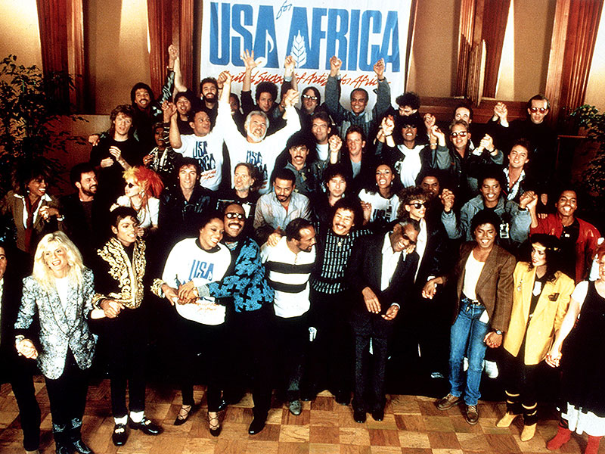
We Are the World
Notes:
Source: http://www.the80srocks.com/wp-content/uploads/2016/04/weare-theworld-800.jpg

Slide 17
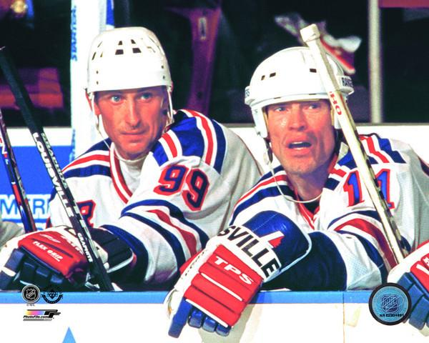
Gretzky and Messier
Notes:
Source: http://www.photofile.com/Original/AA/RY/aary208.jpg

Slide 18
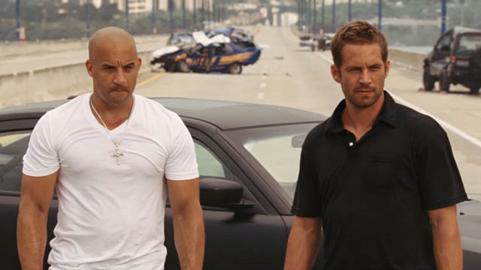
Dominic and Brian
Notes:
Source: http://www.etonline.com/photo/2015/03/24141284/640_dom_brian_bromance.jpg

Slide 19
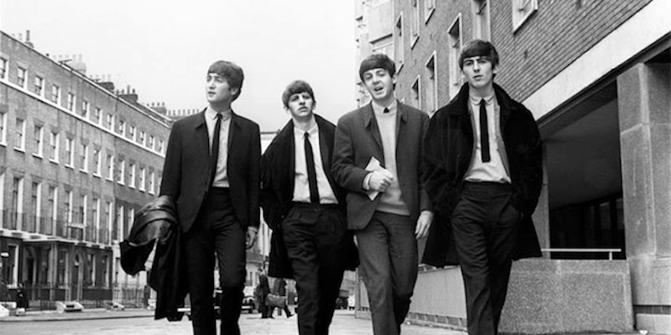
The Beatles
Notes:
Source: http://cdn4.pitchfork.com/news/66941/b305b79a.jpg

Slide 20
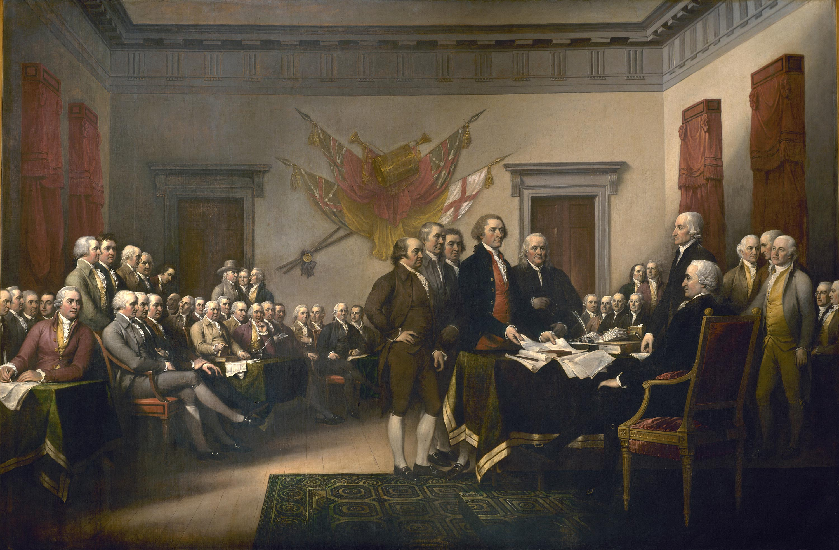
Signers of the Decl. of Independence
Notes:
Source: http://www.history.org/foundation/journal/winter11/painting_magnify/images/painting5.jpg

Slide 21
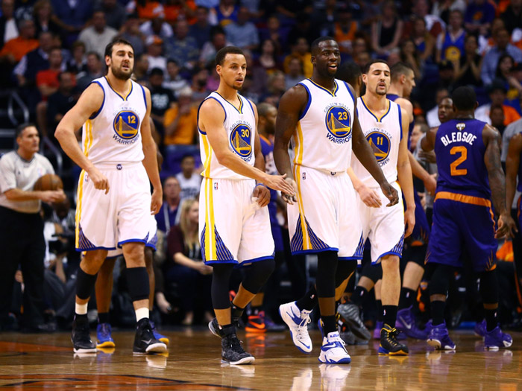
2015 Golden State Warriors
Notes:
Source: http://www.mcgilltribune.com/wp-content/uploads/2016/01/Warriors-Mark-J.-Rebilas-USA-TODAY-Sports-.jpg

Slide 22
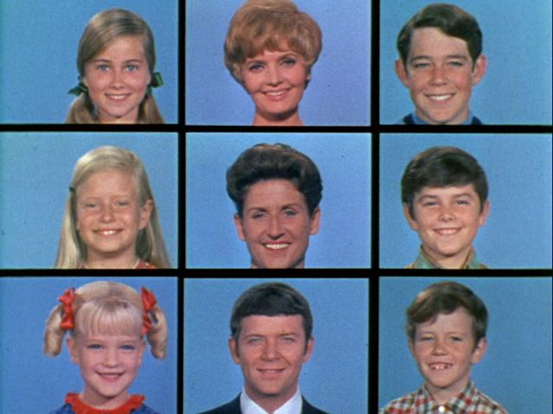
The Brady Bunch
Notes:
Source: http://robinschooling.com/wp-content/uploads/2015/03/Season_1_End.jpg

Slide 23
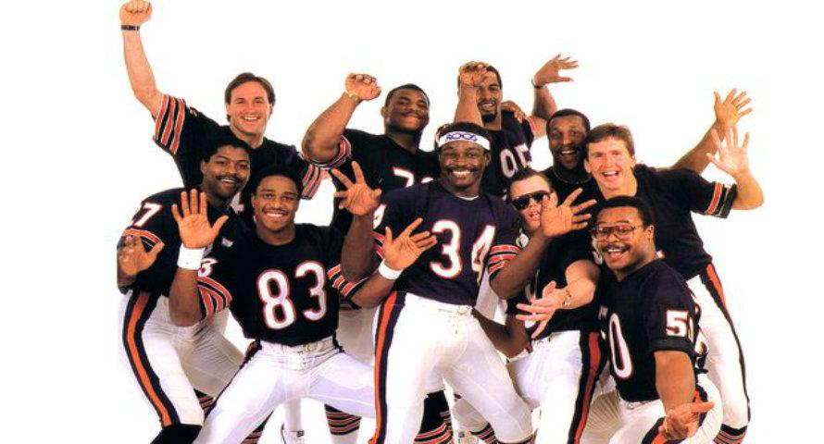
1985 Chicago Bears
Notes:
Source: http://profootballspot.com/uploads/monthly_2016_01/superbowlshuffle2.jpg.eb579b0327fc2c9839b7287d568985ea.jpg

Slide 24
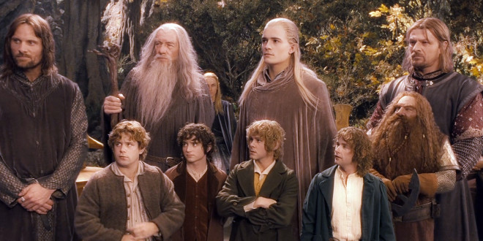
The Fellowship of the Ring (LOTR)
Notes:
Source: http://media.moviehousememories.com/wp-content/uploads/2014/07/The-Lord-of-the-Rings-The-Fellowship-of-the-Ring-01-660x330.jpg

Slide 25

The Powerpuff Girls
Notes:
Source: https://upload.wikimedia.org/wikipedia/en/9/95/Powerpuff_girls_characters.jpg

Slide 26
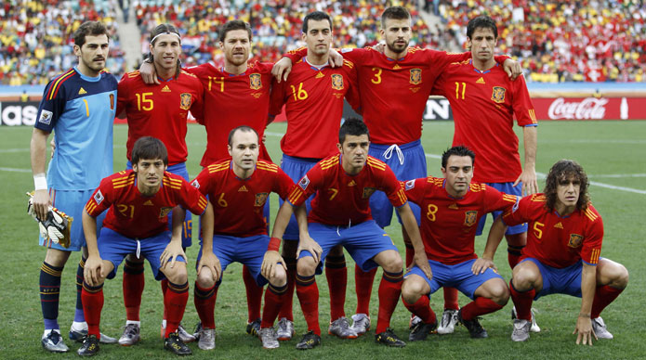
2010 Spain National Team
Notes:
Source: http://3.bp.blogspot.com/_9gcceJohlAk/TLQymxN93wI/AAAAAAAAO38/eE_zvYP1-xM/s1600/Spanish-national-Football-Team-Photo-2010.jpg

Slide 27
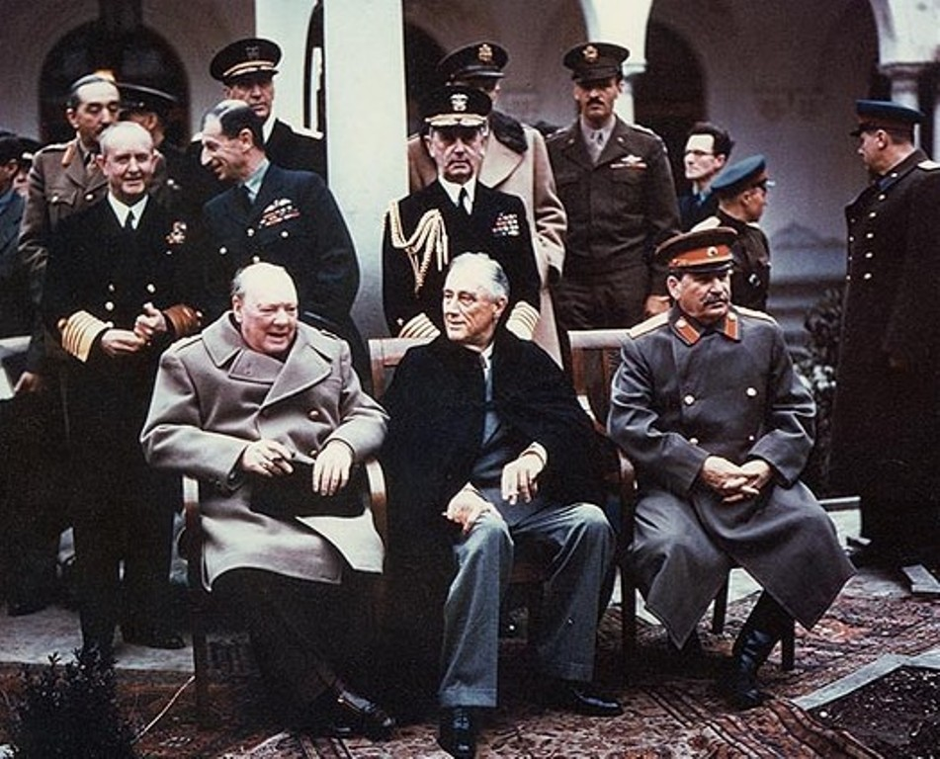
Churchill, FDR, and Stalin
Notes:
Source: https://upload.wikimedia.org/wikipedia/commons/d/d2/Yalta_summit_1945_with_Churchill,_Roosevelt,_Stalin.jpg

Slide 28
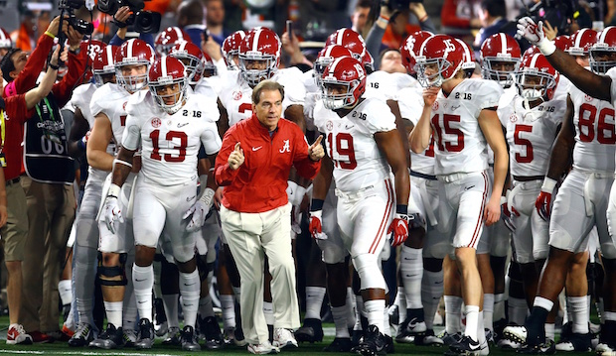
Alabama Crimson Tide
Notes:
Source: http://sportslabs-webproxy.imgix.net/http%3A%2F%2Fstatic.silverchalice.co%2Fci-prod%2F2016%2F07%2F18%2F20160718220954_alabama_football_jpg?s=a8e039dd60ede16444bd0f1e4215b598

Slide 29
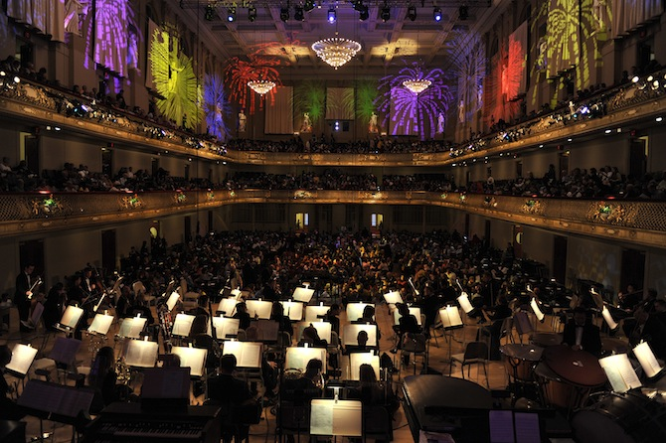
The Boston Pops
Notes:
Source: http://www.massvacation.com/blog/wp-content/uploads/2012/05/670x400-The-Boston-Pops-Stu-Rosner.jpg

Slide 30
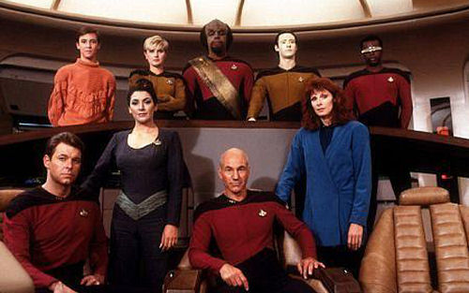
Star Trek: Next Generation
Notes:
Source: http://vignette2.wikia.nocookie.net/memoryalpha/images/0/0e/The_Next_Generation_Main_Cast_Season_1.jpg/revision/latest?cb=20091202034552&path-prefix=en

Slide 31
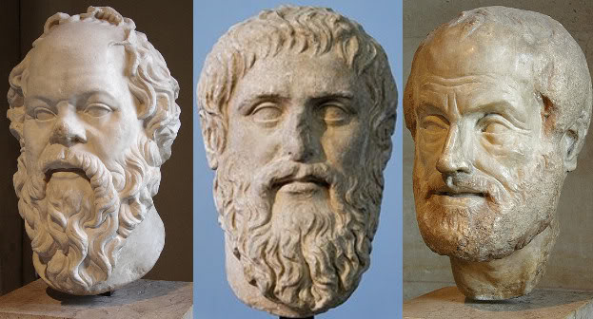
Plato, Aristotle, and Socrates
(Not really a team, but you get the idea)
Notes:
Source: http://www.rechargebiomedical.com/wp-content/uploads/socplatarist.jpeg

Slide 32
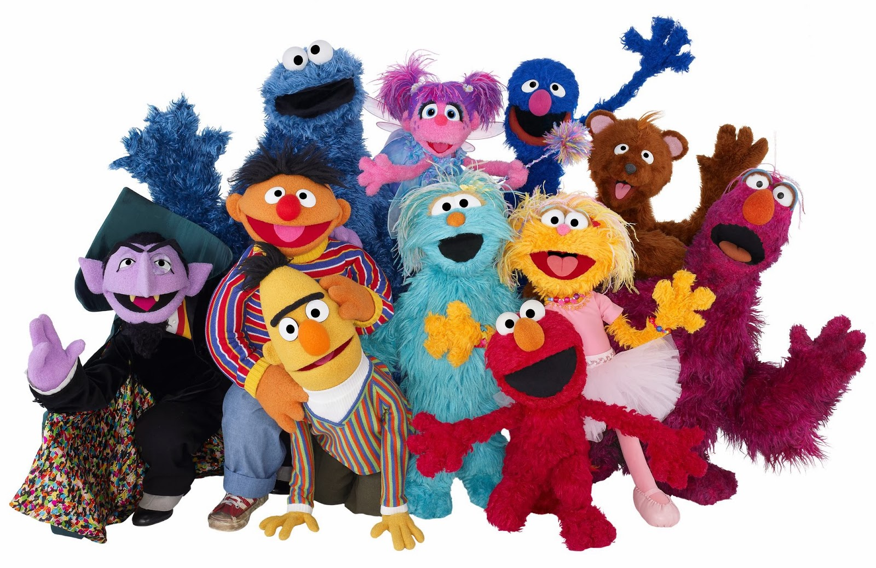
Sesame Street
Notes:
Source: http://vignette2.wikia.nocookie.net/muppet/images/b/bb/MuppetsOfSesameStreet2.jpg/revision/latest?cb=20160516011832

Slide 33
Take-away
Many of these people (or puppets) were incredible as individual performers, thinkers, athletes, etc.
But, none of them individually could compare to the strength of their teams.

Slide 34
Best Practices in Teamwork
ACME Seminar
Notes:
Overview:
Intro (slides 1-4): 2 minutes
Importance of teams (slides 5-9): 5 minutes
Examples of great teams (slides 10-33): 10 minutes
Best Practices (slides 34-40): 10 minutes
Paper towel exercise (41-53): 22 minutes
Wrap-up: 1 minute
Total: 50 minutes

Slide 35
Best Practices
To improve your teams, there are a few tools and principles that will help you:
Build Trust (Vulnerability)
Get Organized (Charter)
Open Communication (Clear, but Kind)

Slide 36
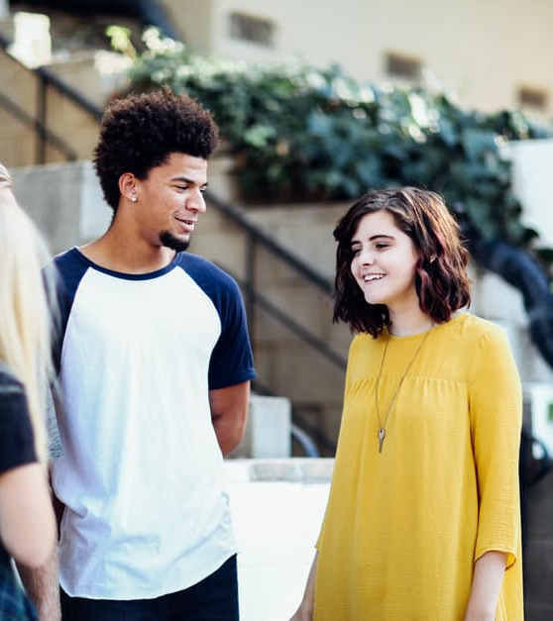
1. Build Trust
Trust is the foundation of teamwork.
To build trust, practice vulnerability and follow through with what you promise to do.
Closed-mindedness, deceit, and social loafing kill trust.
Notes:
Image from https://static.pexels.com/photos/89873/pexels-photo-89873.jpeg

Slide 37
2. Get Organized
Getting organized shows that you want to be a team.
To get organized, draft a team charter:
Team Purpose & Goals
Roles & Responsibilities
Team Norms
Communication Protocol
Research these on your own to learn more and find templates

Slide 38
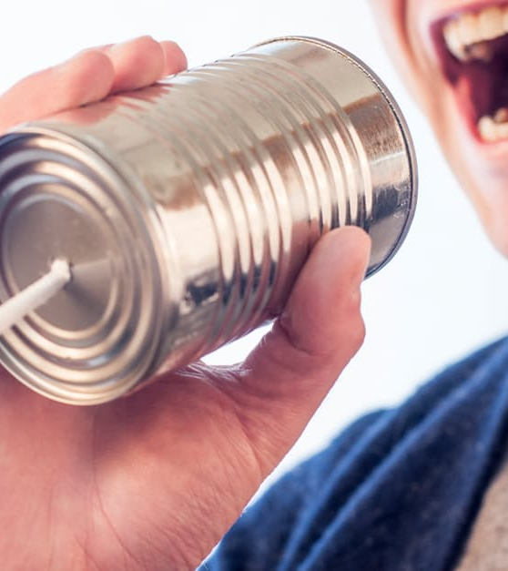
3. Open Communication
Open communication prevents problems and reveals solutions.
To build open communication: be clear, but kind.
“Openness” isn’t necessarily aggressive honesty, venting, or gossiping; avoid these.
Notes:
Image from https://www.pexels.com/photo/marketing-man-person-communication-362/

Slide 39
Reflect (1-2 minutes)
With a neighbor, quickly discuss your favorite aspect of what we just discussed.
Prompts:
Anything that you hadn’t thought about before?
Any ideas of your own?
Anything you don’t agree with?

Slide 40
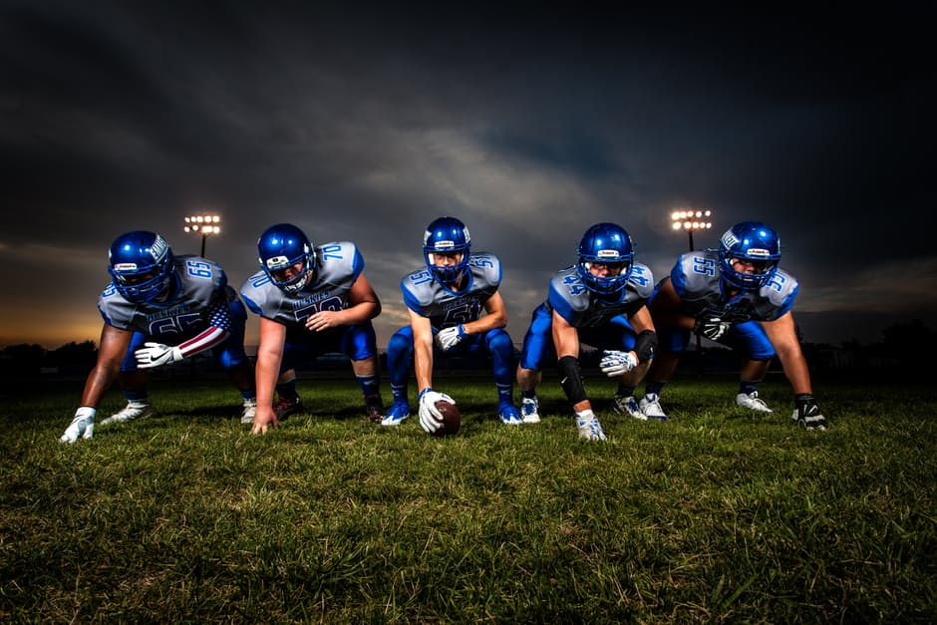
Take-away
Teamwork isn’t an accident; there are specific ways to improve your teams.
Continue to look for best practices and you will find them!
Notes:
Image from https://www.pexels.com/photo/football-players-in-blue-jersey-lined-under-grey-white-cloudy-sky-during-sunset-186076/

Slide 41
Paper Tower Exercise
ACME Seminar

Slide 42
Application
The best way to learn teamwork is to practice it.
Time for some application of the things we’ve discussed.
It’s time for the Paper Tower Exercise!

Slide 43
Instructor: 1. Divide class into groups of 4-5 2. Assign specific areas throughout the classroom to each group

Slide 44
Pre-work (3-5 minutes)
Quickly come up with a team name (yes, this is required)
Gotta Have Blue Hair, DudeMen, Paper People Eaters, etc.
Assign team roles (if you have 4 people, forego one of these)
Team Lead
Director of Construction
Materials Liaison
Strategic Planner
Principal Builder
Notes:
Facilitator: guide students through this process quickly—if you introduce too much ambiguity, you will confuse the students. If they have questions, just tell them to figure it out. Leave it up to them to problem-solve, come up with reasons, why they’re doing what they’re doing, etc.

Slide 45
Exercise: the Paper Tower
Instructions:
In your teams, build the tallest tower, however possible, with the materials provided.
Time: 15 minutes total
Plan (5 minutes)
Build (10 minutes)
Notes:
Instructor:
Explain the activity to the teams, including the time limits and rules.
Once the students understand the rules (next slide), show them where the materials are

Slide 46
Exercise: the Paper Tower
Rules:
Be creative. Be different. Or not—just make a tall tower.
Every team member must participate.
Towers will be built on the ground.
Tower must be self-sustaining; people or other materials (ceiling, chairs, etc.) can’t support it.
Notes:
Instructor:
Explain the activity to the teams, including the time limits and rules.
Once the students understand the rules, show them where the materials are

Slide 47
Plan! 5 mins. How will you do this? What is your strategy? How will you use each person?
Notes:
Be clear with the start and end times, and be strict. (but fun)

Slide 48
Build! 10 mins. Be wild. Be creative. Use every person. On the ground; self-sustaining.
Notes:
Be clear with the start and end times, and be strict. (but fun)

Slide 49
Who won? Height?

Slide 50
Evaluate Which tower was tallest? Which tower was most creative? Which team worked best?

Slide 51
Awards Ceremony
Notes:
Facilitator – knight the winners or give them some other reward with little/no value (e.g., praise their choices)

Slide 52
Reflect
Reflect as a class:
Did you do better/worse than you thought you would?
Winning team: was your success correlated to your teamwork? Why, or why not?
Which of the three best practices did your team use? Which could you have used more effectively?

Slide 53
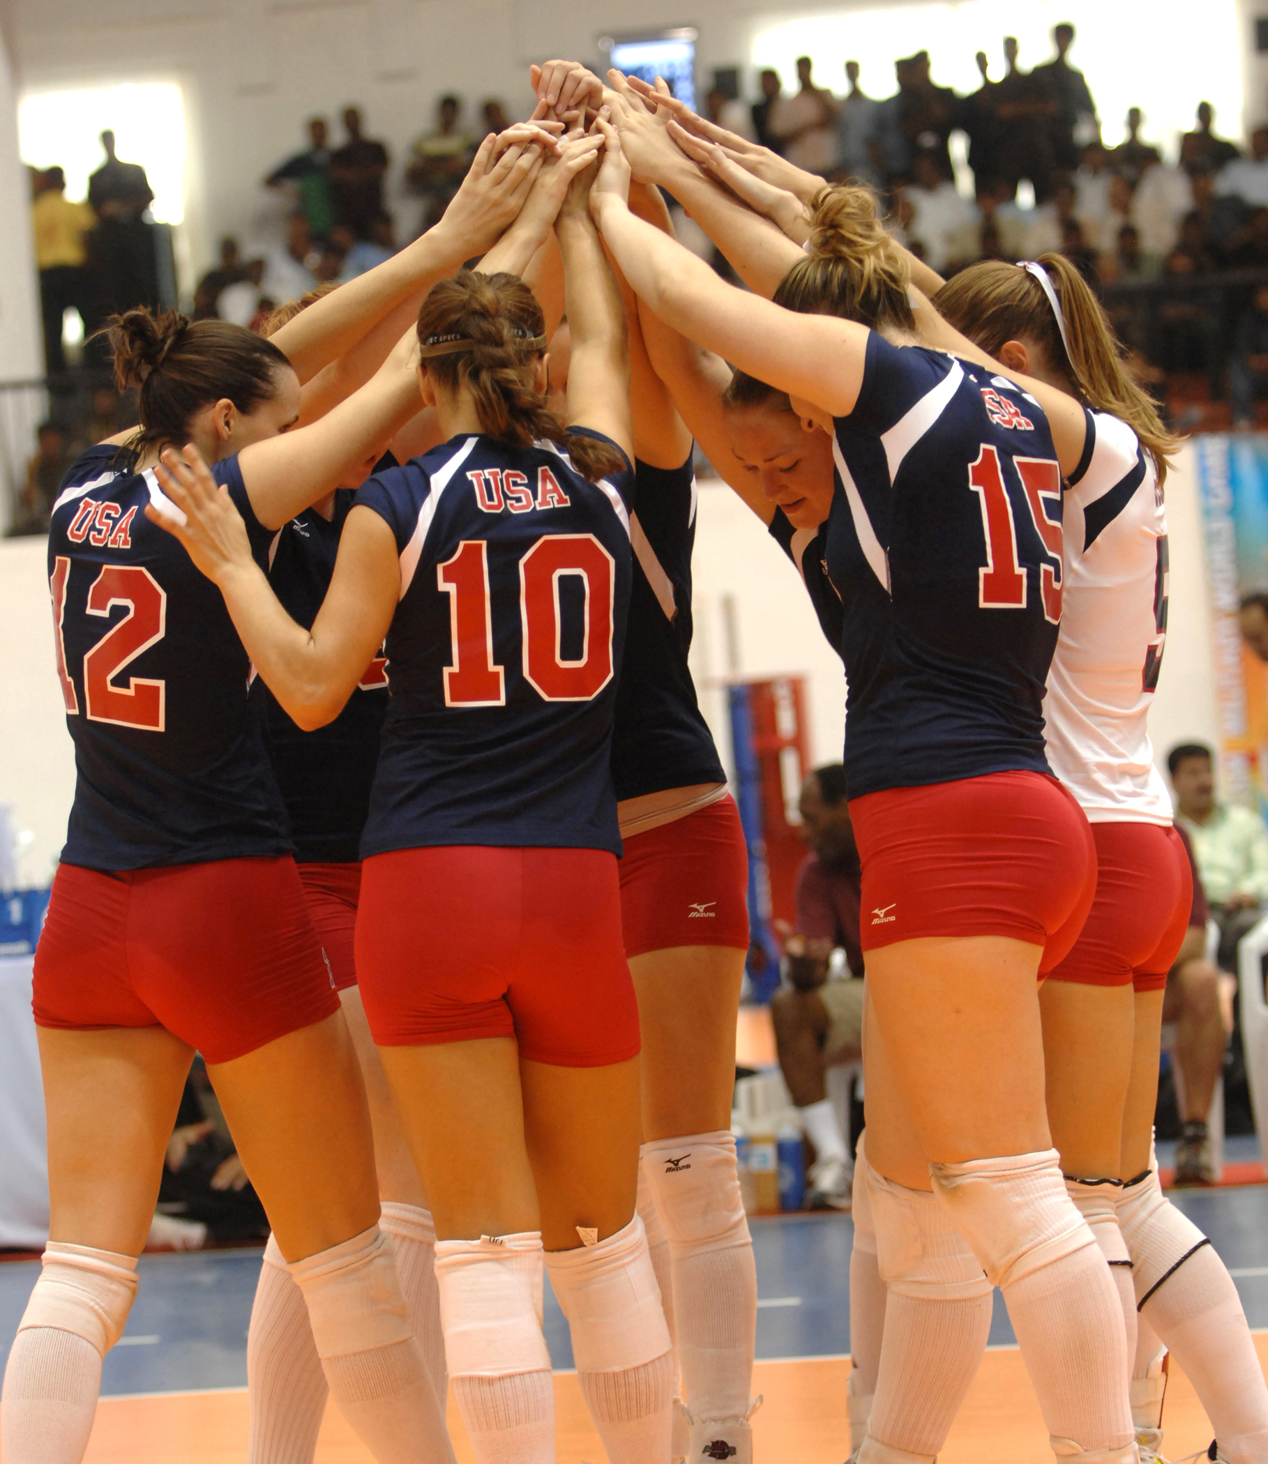
Take-away
A well-organized team is better than any individual.
“The whole is more than the sum of its parts.”
Gestalt Philosophy
Notes:
Image from https://commons.wikimedia.org/wiki/File:U.S._Womens_Volleyball_team_CISM_2007.jpg

Slide 54
Outcomes
Discuss the importance of teams
Watch examples of great teams in action
Identify best practices in teamwork
Participate in Paper Tower exercise

Slide 55
Additional resources
The Five Dysfunctions of a Team by Patrick Lencioni
Team Charters: what are they and what’s their purpose?

Slide 56

Content (not images or videos) copyright information:

